Slide 1
IT’S OUR MOVE:
GOOD WORKERS
1 Peter 2:18-25

Slide 2
SERIES ON 1 PETER
Identity: Exiles on a Mission

Slide 3
SERIES ON 1 PETER
Identity: Exiles on a Mission
OUR MOVE

Slide 4
SERIES ON 1 PETER
Identity: Exiles on a Mission
OUR MOVE:
Neighbor
Citizen

Slide 5
SERIES ON 1 PETER
Identity: Exiles on a Mission
OUR MOVE:
Neighbor
Citizen
Worker

Slide 6
1 Peter 2:12
“So that. . . They may see your good deeds and glorify God.”

Slide 7
1 Peter 2:18-25

Slide 8
1 Peter 2:18-25
Servants, be subject to your masters with all respect, not only to the good and gentle but also to the unjust. For this is a gracious thing, when, mindful of God, one endures sorrows while suffering unjustly. For what credit is it if, when you sin and are beaten for it, you endure? But if when you do good and suffer for it you endure, this is a gracious thing in the sight of God.

Slide 9
1 Peter 2:18-25
For to this you have been called, because Christ also suffered for you, leaving you an example, so that you might follow in his steps. He committed no sin, neither was deceit found in his mouth. When he was reviled, he did not revile in return; when he suffered, he did not threaten, but continued entrusting himself to him who judges justly.

Slide 10
1 Peter 2:18-25
He himself bore our sins in his body on the tree, that we might die to sin and live to righteousness. By his wounds you have been healed. For you were straying like sheep, but have now returned to the Shepherd and Overseer of your souls.

Slide 11
1 Peter 2:18
Servants, be subject to your masters with all respect, not only to the good and gentle but also to the unjust.

Slide 12
Mark 10:43-44
But whoever would be great among you must be your servant, and whoever would be first among you must be slave of all.

Slide 13
1 Peter 2:18
Servants, be subject to your masters with all respect, not only to the good and gentle but also to the unjust.

Slide 14
1 Peter 2:18
Servants, be subject to your masters with all respect, not only to the good and gentle but also to the unjust.

Slide 15
Colossians 3:22
Bondservants, obey in everything those who are your earthly masters, not by way of eye-service, as people-pleasers, but with sincerity of heart, fearing the Lord. Whatever you do, work heartily, as for the Lord and not for men.

Slide 16
Matthew 5

Slide 17
Matthew 5
Do not kill, or be angry
Do not commit adultery, or lust

Slide 18
Matthew 5:43-45
You have heard that it was said, “You shall love your neighbor and hate your enemy.” But I say to you, love your enemies and pray for those who persecute you, so that you may be sons of your Father who is in heaven.

Slide 19
1 Peter 2:19
For this is a gracious thing, when, mindful of God, one endures sorrows while suffering unjustly.

Slide 20
1 Peter 2:20
For what credit is it, if, when you sin and are beaten for it, you endure? But if when you do good and suffer for it you endure, this is a gracious thing in the sight of God.

Slide 21
John Calvin
For such is our disposition, that when we receive injuries, our minds immediately boil over with revengeful feelings; but Christ abstained from every kind of retaliation. Our minds, therefore, ought to be bridled, lest we should seek to render evil for evil.

Slide 22
1 Peter 2:20
For what credit is it, if, when you sin and are beaten for it, you endure? But if when you do good and suffer for it you endure, this is a gracious thing in the sight of God.

Slide 23
2 Corinthians 5:14
For the love of Christ controls us, because we have concluded this: that one has died for all, therefore all have died; and he died for all, that those who live might no longer live for themselves but for him who for their sake died and was raised.

Slide 24
1 Peter 2:21
For to this you have been called, because Christ also suffered for you, leaving you an example, so that you might follow in his steps.

Slide 25
1 Peter 2:21
For to this you have been called, because Christ also suffered for you, leaving you an example, so that you might follow in his steps..

Slide 26
1 Peter 2:22-24
He committed no sin, neither was deceit found in his mouth. When he was reviled, he did not revile in return; when he suffered, he did not threaten, but continued entrusting himself to Him who judges justly. He himself bore our sins in his body on the tree, that we might die to sin and live to righteousness.

Slide 27
1 Peter 2:22
He committed no sin, neither was deceit found in his mouth. When he was reviled, he did not revile in return; when he suffered, he did not threaten, but continued entrusting himself to Him who judges justly. He himself bore our sins in his body on the tree, that we might die to sin and live to righteousness.

Slide 28
1 Peter 2:22-24
He committed no sin, neither was deceit found in his mouth. When he was reviled, he did not revile in return; when he suffered, he did not threaten, but continued entrusting himself to Him who judges justly. He himself bore our sins in his body on the tree, that we might die to sin and live to righteousness.

Slide 29
1 Peter 2:25
For you were straying like sheep, but have now returned to the Shepherd and Overseer of your souls.

Slide 30
OUR MOVE

Slide 31
OUR MOVE
Contagiously Glorify

Slide 32
OUR MOVE
Contagiously Glorify
Be subject

Slide 33
OUR MOVE
Contagiously Glorify
Be subject
Be different

Slide 34
Richard Pratt:
“The Great King has summoned each of us into his throne room. ‘Take this portion of my kingdom,’ he says. ‘I am making you my steward over your office, your workbench, your kitchen stove. Put your heart into mastering this part of my world. Get it in order; unearth its treasures; do all you can with it. Then everyone will see what a glorious King I am.’”

Slide 35
OUR MOVE

Slide 36
OUR MOVE
Peter is not saying:

Slide 37
OUR MOVE
Peter is not saying:
Earthly master is above Heavenly Master

Slide 38
OUR MOVE
Peter is not saying:
Earthly master is above Heavenly Master
Cannot address your concerns respectfully

Slide 39
OUR MOVE
Peter is not saying:
Earthly master is above Heavenly Master
Cannot address your concerns respectfully
Cannot find a better job

Slide 40
OUR MOVE

Slide 41
OUR MOVE
Plan to submit

Slide 42
OUR MOVE
Plan to submit
Pray for your boss

Slide 43
OUR MOVE
Plan to submit
Pray for your boss
Study your example

Slide 44
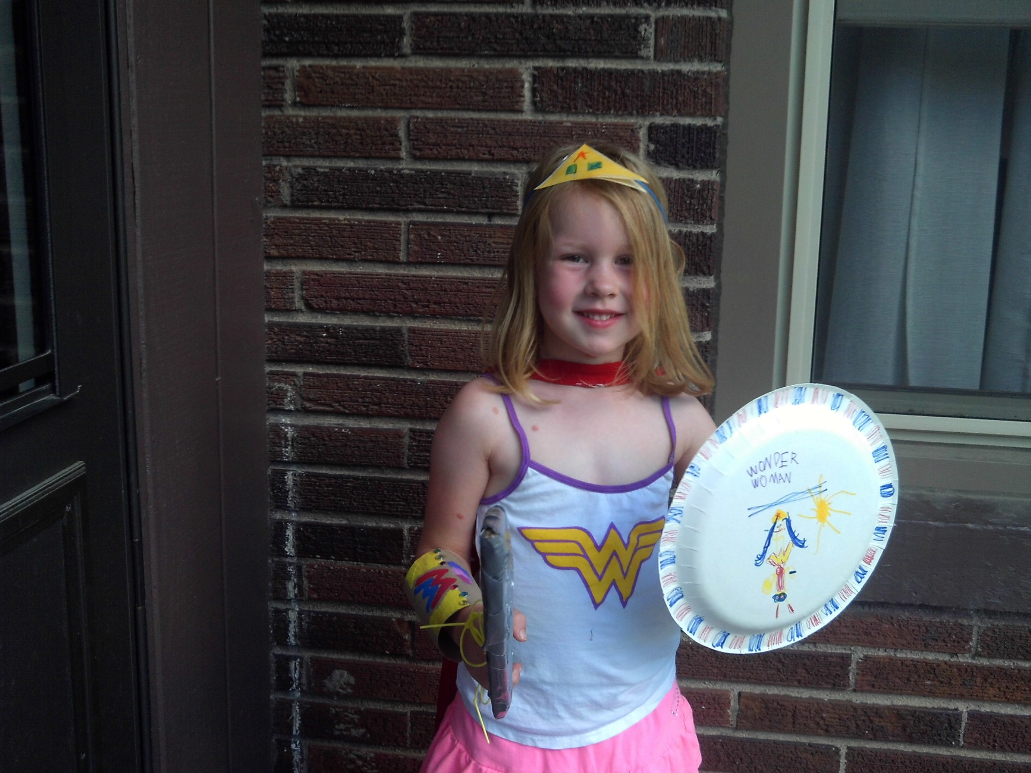

Slide 45


Slide 46
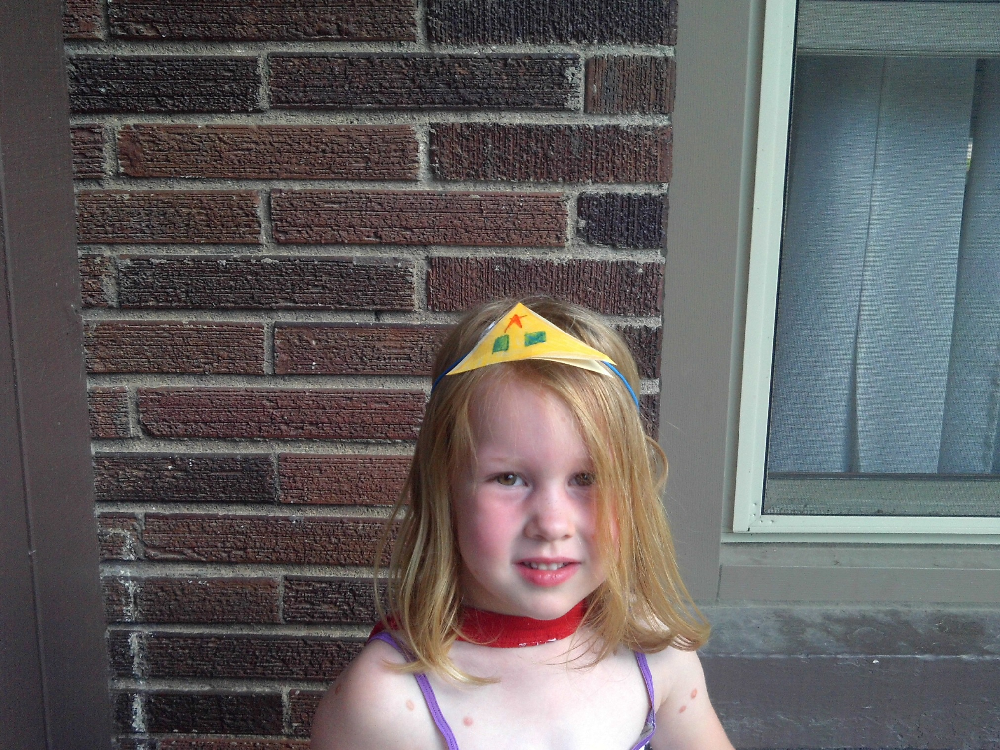

Slide 47
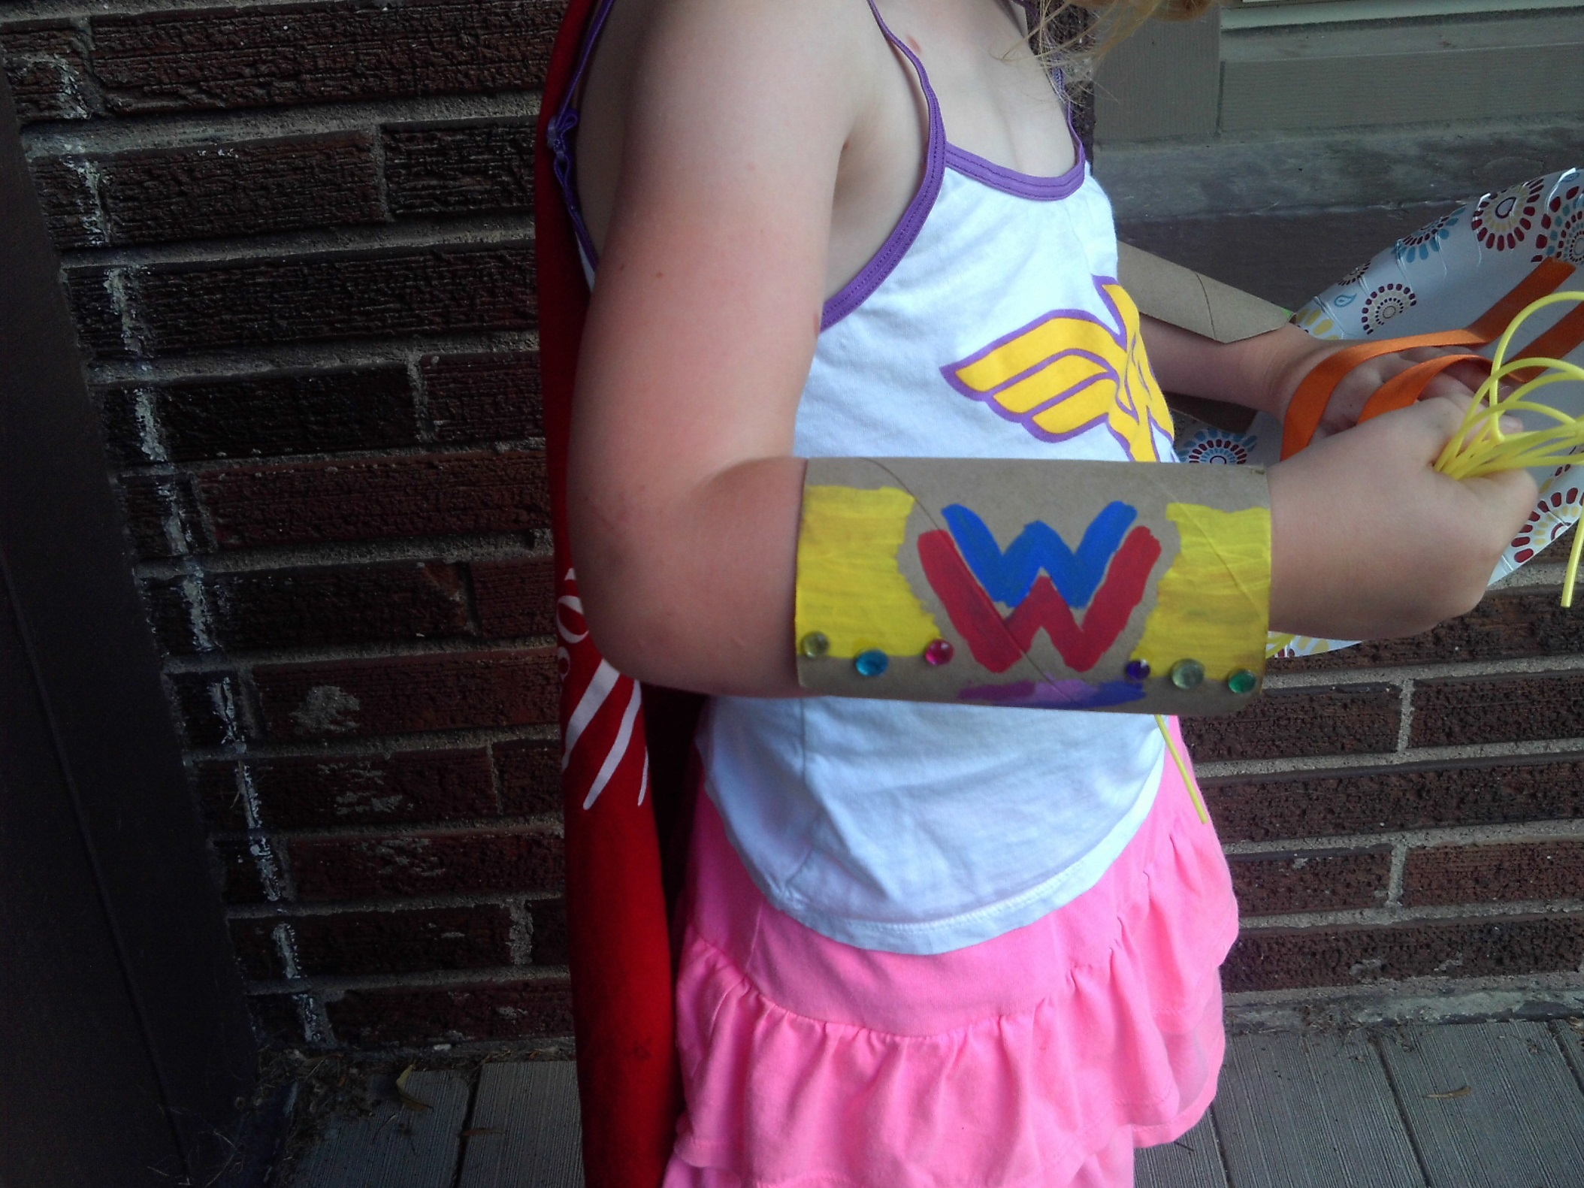

Slide 49
OUR MOVE
Plan to submit
Pray for your boss
Study your example

Slide 50
IT’S OUR MOVE

